Slide 1
CTS 6319 Cyber Security: Measurement and Data Analysis
Dr. Elias Bou-Harb
ebouharb@fau.edu EE 503B
Office hours: Mondays 4-6pm

Slide 2
Material
On Canvas
Research Paper 3:
Amplification Hell: Revisiting Network Protocols for DDoS Abuse

Slide 3
Distributed Reflective Denial-of-Service (DRDoS) Attacks
Reflective: A does not directly send traffic to V
but instead uses systems that reflect the attack traffic to V
Distributed: A employs many hosts to launch attacks towards A
In the context of DRDoS, systems that are used to attack A are called amplifiers. Thus, the term “Amplification Attacks”
Amplifiers are not infected or controlled, just used as reflectors (recall ICMP Flooding attacks)

Slide 4
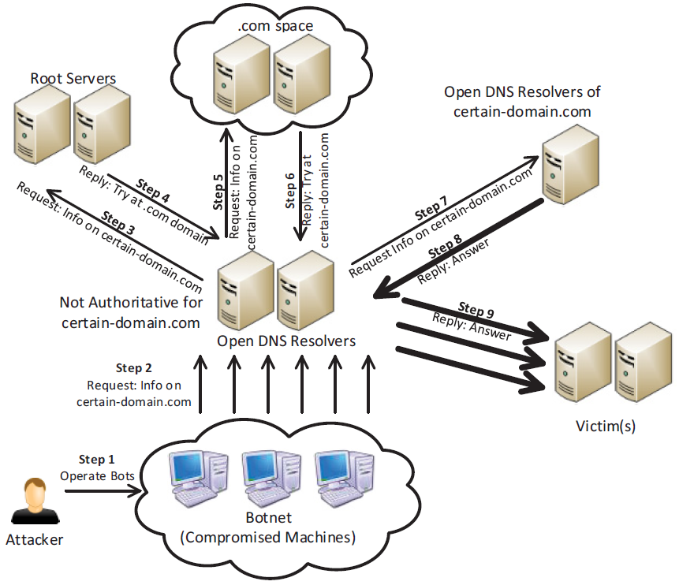
Distributed Reflective Denial-of-Service (DRDoS) Attacks

Slide 5
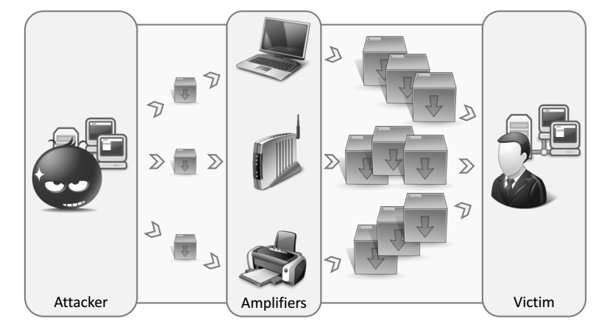
Distributed Reflective Denial-of-Service (DRDoS) Attacks

Slide 6
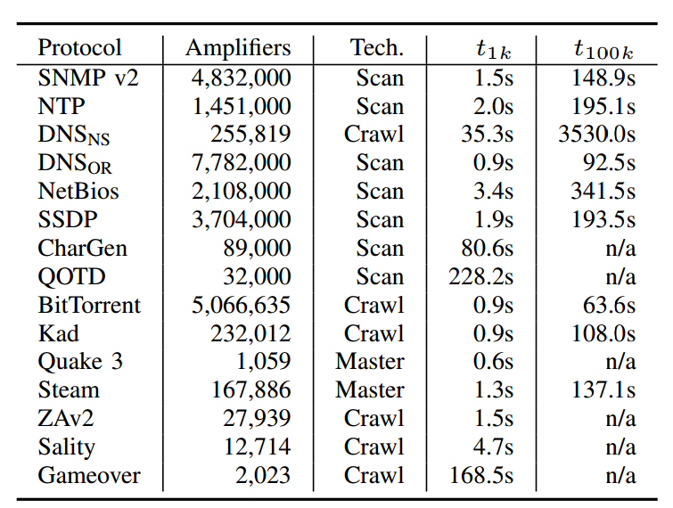
Distributed Reflective Denial-of-Service (DRDoS) Attacks

Slide 7
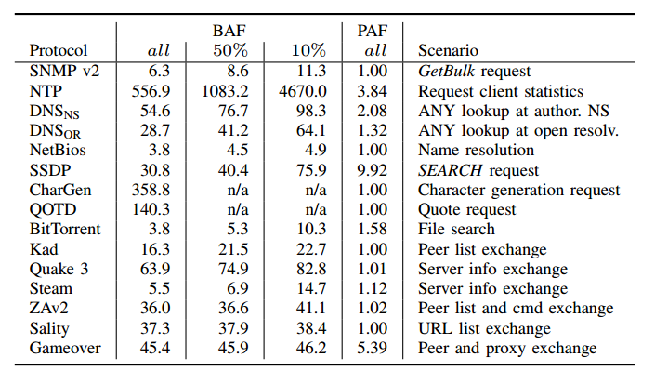
Distributed Reflective Denial-of-Service (DRDoS) Attacks

Slide 8
Distributed Reflective Denial-of-Service (DRDoS) Attacks
Analyzed Period: February, March and April, 2014
Old 2007 study: ANY queries ranked 6th (0.0199%)
Our 2014 study: ANY queries ranked 1st (52.23%)
February Packet Count (%) | March Packet Count (%) | April Packet Count (%)
10047038 A (49.02%) | 27649274 ANY (64.23%) | 18378685 ANY (54.60%)
7763817 ANY (37.88%) | 11310058 A (26.28%) | 11595908 A (34.45%)
2479572 TXT (12.10%) | 2459257 TXT (5.71%) | 3402073 TXT (10.11%)
100463 MX (0.49%) | 500143 MX (1.16%) | 180779 MX (0.54%)
29232 PTR (0.14%) | 63340 RRSIG (0.15%) | 28716 AAAA (0.09%)

Slide 9
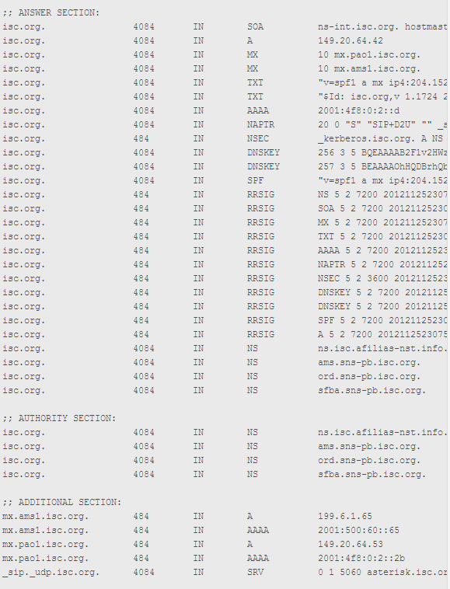
Distributed Reflective Denial-of-Service (DRDoS) Attacks
DNS Amplification
dig ANY isc.org @x.x.x.x

Slide 10
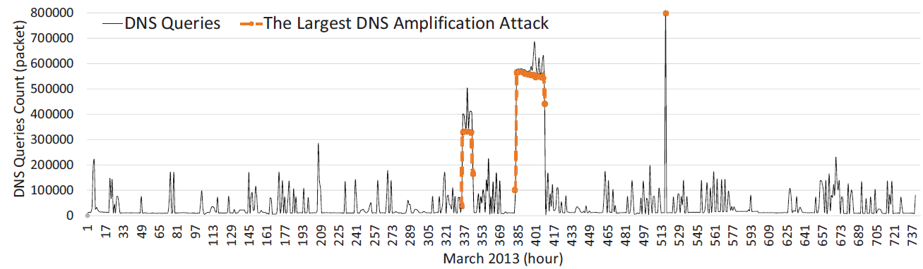
Distributed Reflective Denial-of-Service (DRDoS) Attacks

Slide 11
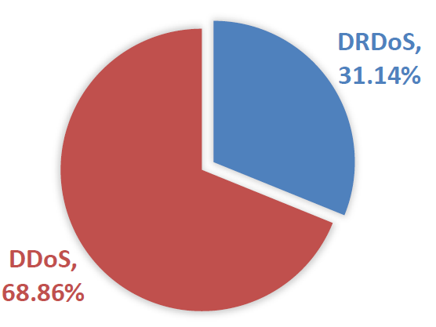
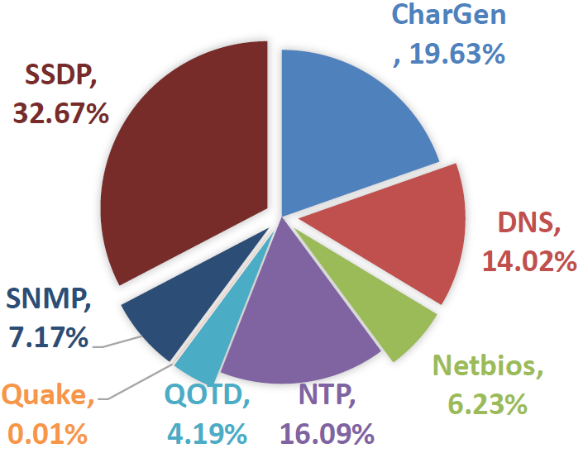
Distributed Reflective Denial-of-Service (DRDoS) Attacks

Slide 12
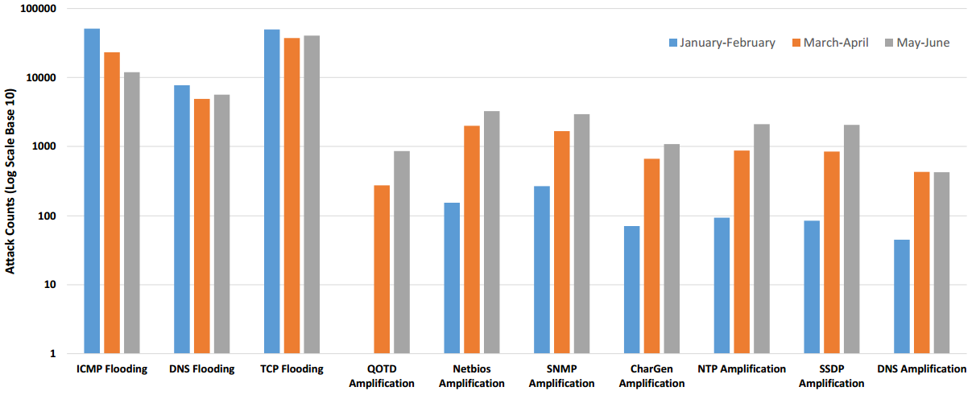
Distributed Reflective Denial-of-Service (DRDoS) Attacks

Slide 13
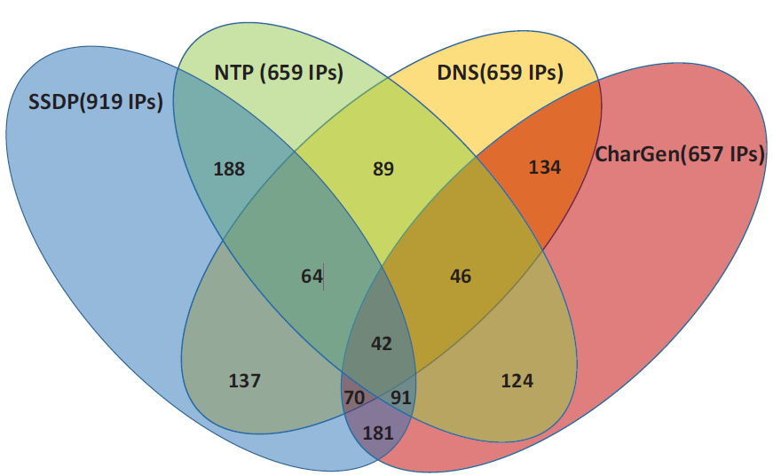
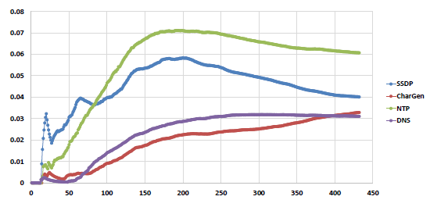
Distributed Reflective Denial-of-Service (DRDoS) Attacks

Slide 14
Countermeasures
Prevent IP address Spoofing
Protocol Handling
Session establishment
Request/Response Symmetry
Rate Limiting
Secure server configuration
Packet-based filtering

Slide 15
CTS 6319 Cyber Security: Measurement and Data Analysis
Dr. Elias Bou-Harb
ebouharb@fau.edu EE 503B
Office hours: Mondays 4-6pm
http://faculty.eng.fau.edu/ebouharb/

